Slide 1
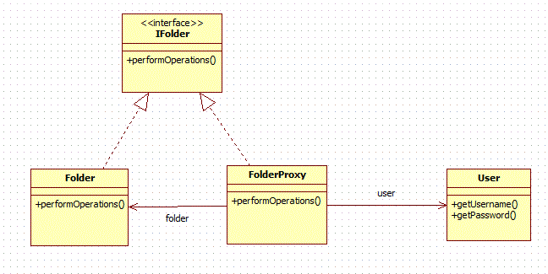
Proxy Design Pattern
ProexyTest

